Slide 1
Introduction to Statistics, R, and RStudio
Julianna Calabrese
Wednesday, October 2nd, 2019
Notes:
Last updated September 29th 2019

Slide 2
Why Statistics is Important

Slide 3
Introduction to Statistics
Statistics is the science of learning from data
We can use data to make models and predictions about the world and populations
Used in almost every profession and field
Scientific research wouldn’t exist without statistics

Slide 4
Why you should care about statistics
Required for majors in Neuroscience, Psychology, and BCN
Data analysis/statistics on the GRE
Undergraduate statistics recommended or required for graduate school in psychology and other social science programs
Knowledge of statistics and programming looks great on a resume for industry jobs
Programming makes tasks easier and less time-consuming
Can’t do research without statistics

Slide 5
Why you should care about statistics even if you’re pre-med
Likely required for your undergraduate major
Undergraduate statistics required or recommended for admission to many medical schools
Part of medical school curriculum
Statistical reasoning on the MCAT
Biostatistics on the USMLE
Helpful overall in being a doctor
Can’t do research without statistics

Slide 6
Statistical Software:
R & RStudio

Slide 7
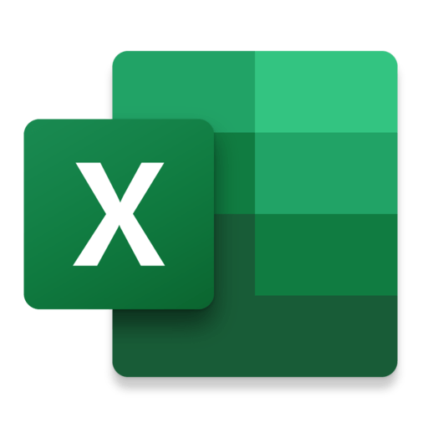
Statistical programs & programming languages
Management, organization, analysis, and presentation of data
Can do the hard part of statistics for you
It can’t interpret your results, though
“Point-and-click” versus coding

Slide 8
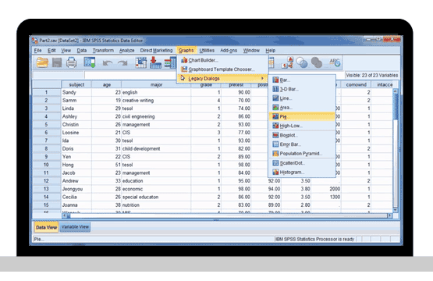
“Point-and-click” programs: SPSS
Pros:
Easy to learn
Can just click on buttons
Cons:
Slow, inflexible
$$$
Hard to keep track of what you did and in what order

Slide 9
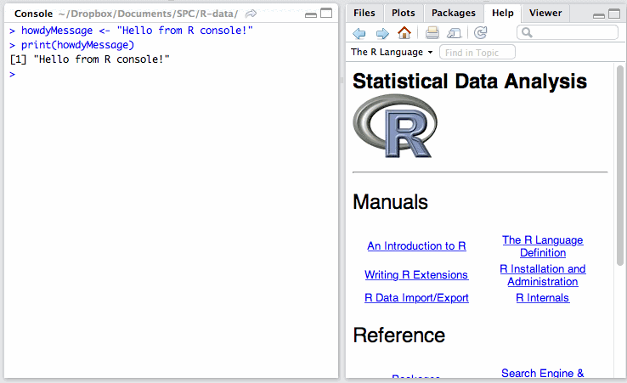
Coding-based programs: R
Pros:
Free, open-source
Customizable
Easy to track changes
Easy to share code with others
Cons:
Steep learning curve
Not intuitive

Slide 10
R versus RStudio
R is a programming language specifically designed for statistical analysis in academia and industry
RStudio is an “integrated development environment” for R
RStudio is R but with a pretty userface and more features
R is the car’s engine, RStudio is the car’s dashboard

Slide 11
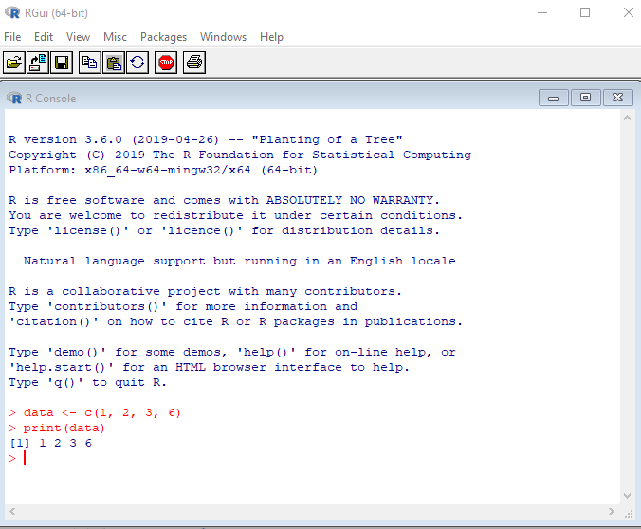
Base R
No buttons or gimmicks
Just the programming language

Slide 12
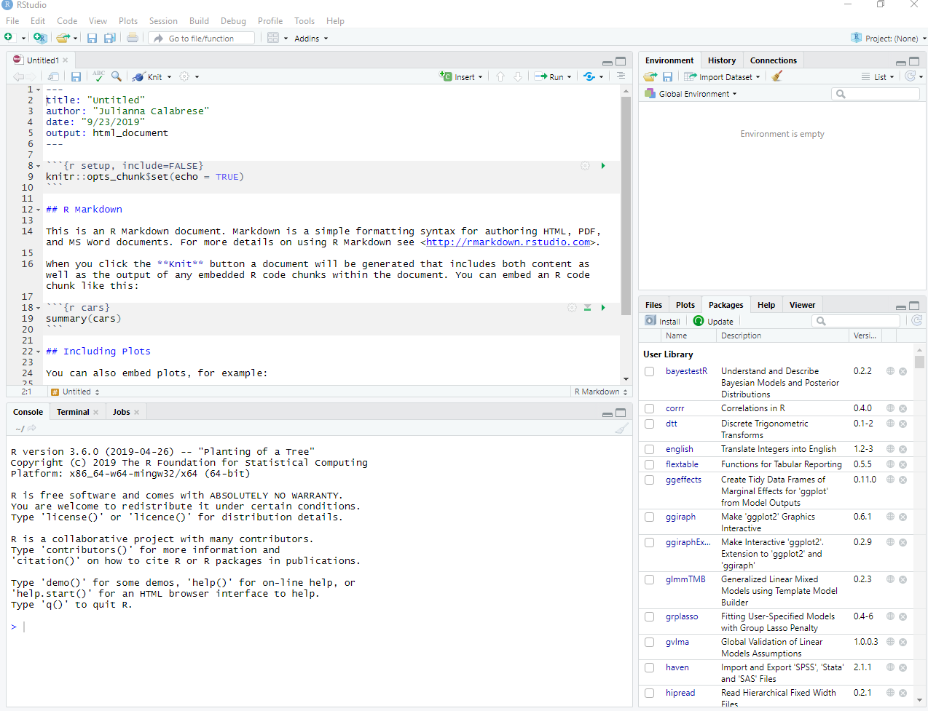
RStudio
More windows and features
Better graphs
Can open RMarkdown files

Slide 14
How to Use RStudio

Slide 15
What do all the buttons do?
Dataframes
Objects/variables
Custom functions
History of commands you previously entered
Notes:
The panel in the upper right contains your Environment as well as a History of the commands that you’ve previously entered. Your Environment contains any objects or variables you’ve created or datasets that you have read into RStudio.

Slide 16
What do all the buttons do?
Files in your current directory
Plots you created
Packages installed
Notes:
Any plots that you generate will show up in the panel in the lower right corner under the Plots tab or will appear directly in the RMarkdown document directly below the code. This panel also allows you to see what packages you have installed and any files in your current directory.

Slide 17
What do all the buttons do?
Console is where the stuff happens
Note: commands entered in the Console are not saved
Notes:
The panel on below is where the action happens. It’s called the Console. Everytime you launch RStudio, it will have the same text at the top of the console telling you the version of R that you’re running. Below that information is the prompt where you can input commands. However, any commands only entered into the Console will not be saved.

Slide 18
What do all the buttons do?
Open RMarkdown files in the Panel
RMarkdown is like Microsoft Word — write code here, make comments, save your work, email to a collaborator
Notes:
The panel in the top left opens syntax files. The only syntax file that you should know is RMarkdown. Think of it as a Word Document but for statistics. You can save what you do and (importantly) the order that you do it in.

Slide 19
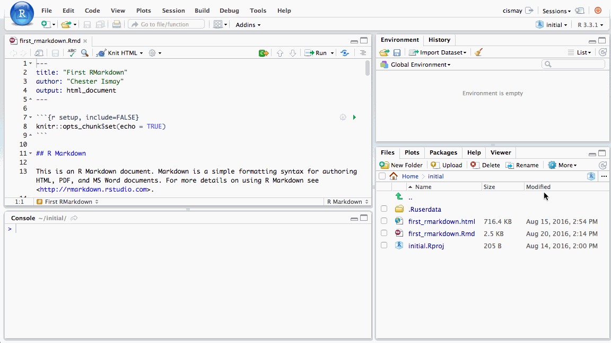
What is RMarkdown?
Create dynamic and interactive documents
Include written paragraphs and statistical code
Embed statistical results, tables, and plots
Can be exported to HTML or PDF

Slide 20
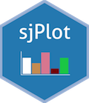
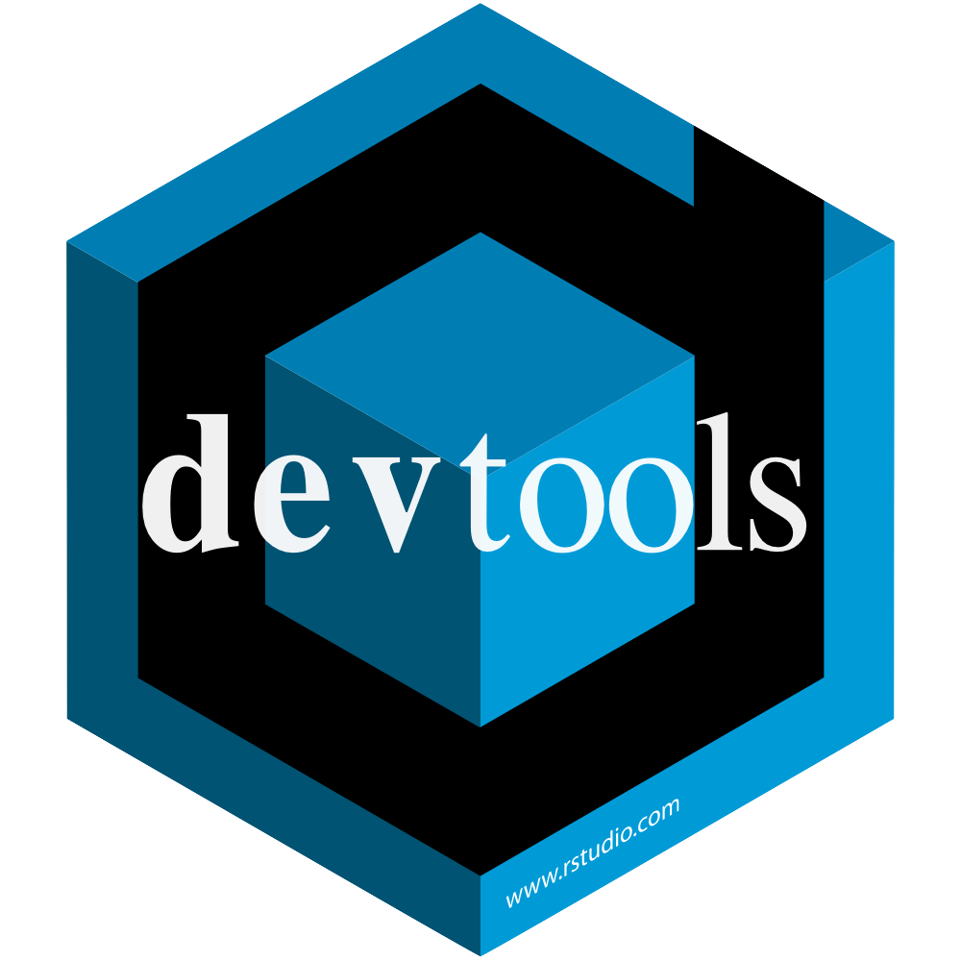
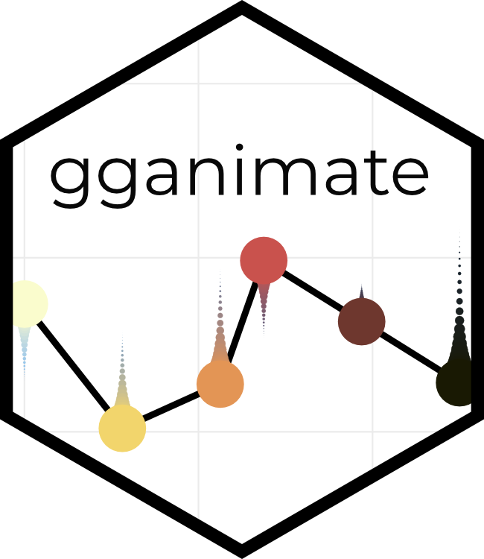
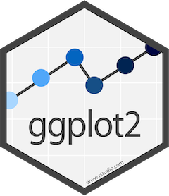
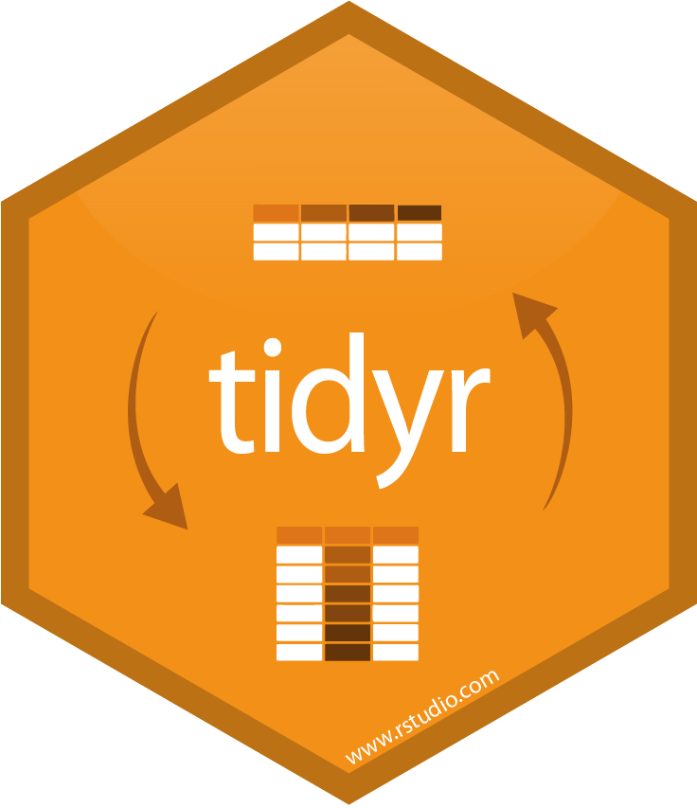
What are packages?
Packages help you perform specific tasks (e.g. making graphs)
Packages are like smartphone apps — you can use your phone without them, but so many benefits come with downloading them
Must be loaded in again every time you use RStudio

Slide 21
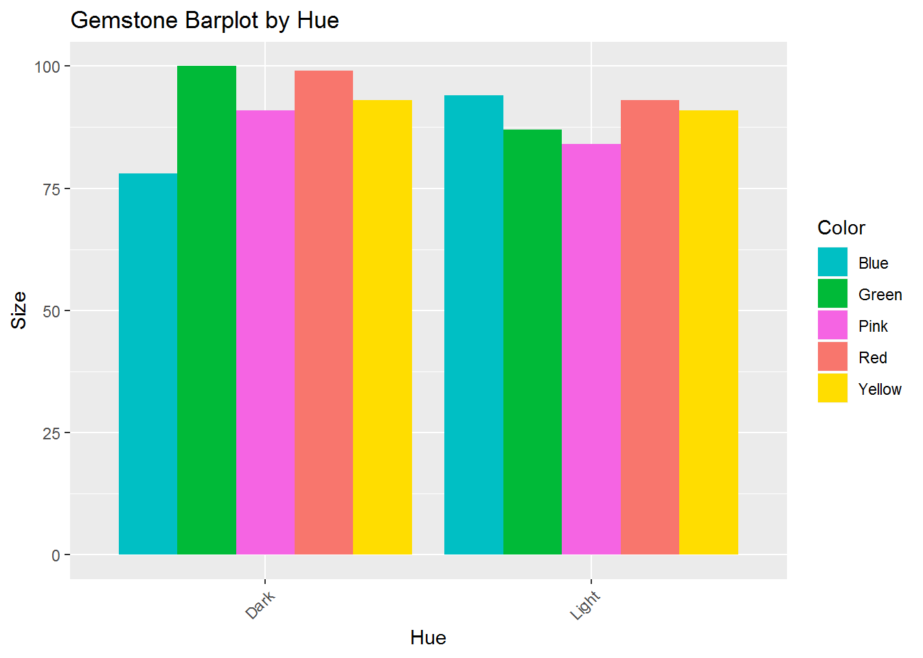
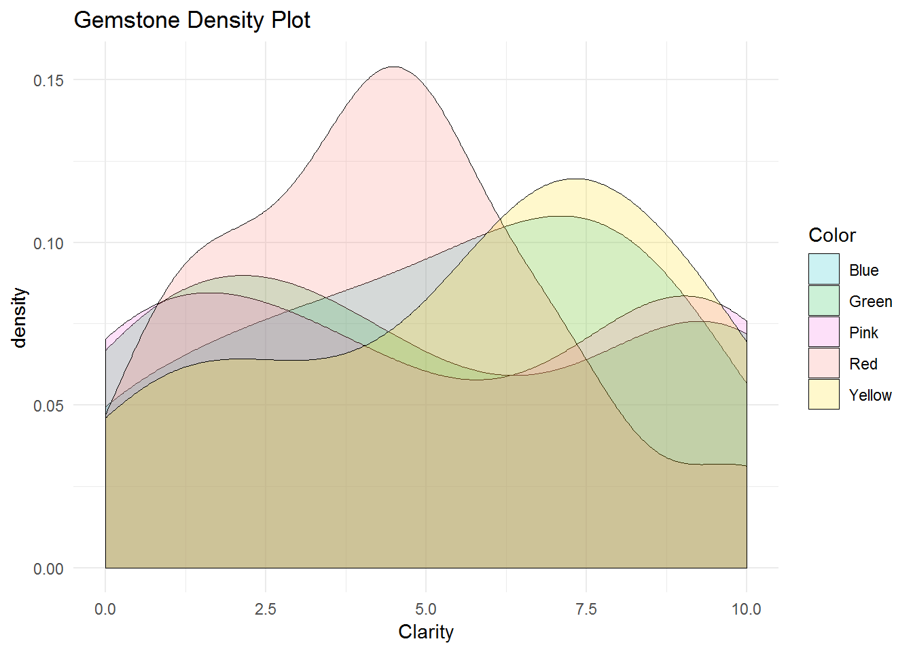
ggplot2 examples
geom_bar (barplots)
geom_density (density plots)

Slide 22
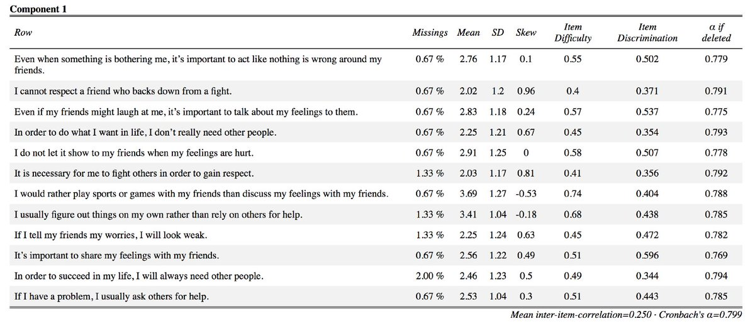
sjPlot example: tab_model()
Definition: tab_model() creates HTML tables from regression models (never fight with Word Document tables again!)

Slide 23
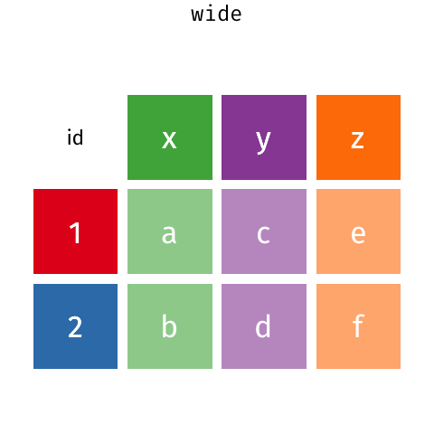
tidyr example: gather()
Definition: gather() takes multiple columns and collapses into key-value pairs, duplicating all other columns as needed
source

Slide 24
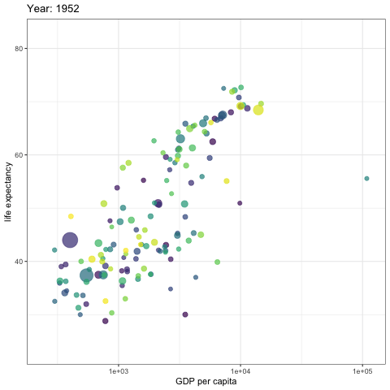
gganimate example: gg_animate()
Definition: gg_animate() shows an animation of a ggplot2 object that contains a frame aesthetic
source

Slide 25
Why we need RAs to know R
Get data from Point A to Point B
Qualtrics → REDCap → Excel
Every time data goes between programs, the data structure needs to be manipulated, which R can help with
Recruitment purposes
Enter participants into Ripple automatically instead of one-by-one
Preliminary analyses
What’s the average time it takes to recruit someone?
What are the average scores of depression, anxiety, etc. for the participants we’ve recruited so far?

Slide 26
Cheatsheets & How to Learn More
Cheatsheets made for TaDLab RAs:
Introduction to R for TaDLab RAs
TaDLab’s Guide to Making Pretty RMarkdown Documents
The Basics of Data Wrangling
A Very Short Review of ggplot2
How to learn more
swirl(): a package that teaches you R in R. To run Swirl, type this in the R console:
install.packages(“swirl”)
library(swirl)
An Introduction to Statistical and Data Sciences via R
Attend CSCAR workshops at UM
Take advanced statistics courses and seminars

Slide 27
Any questions?

